Slide 1
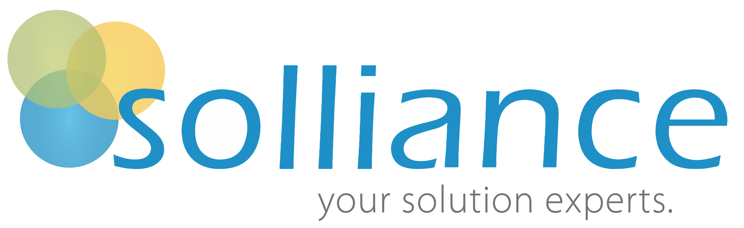



Tiffany Duppong is a Consultant and Trainer focused on Microsoft Dynamics 365 and the Power platform.​
​
Tiffany helps foster organizational success as a consultant focusing on the functional architecture of the Power Platform. A jack-of-all-trades, she is often with an implementation throughout its lifecycle; from demo to deployment.
​
As a trainer and coach, she is enthusiastic about coaching individuals looking to discover how the Microsoft Business Applications platform can positively impact their live and businesses. She is additionally involved in delivering training documentation to Microsoft and their partners.
​
Tiffany Duppong
Business Applications Consultant
tiffany@solliance.net
@duwellcrm
Notes:
Started as a system admin and discovered Dynamics 365 – before the Power Platform
Did close to 20 implementations in her first 2 years and discovered a love of working the entire process – from sales to final go live
Work for Partners, Customers and Microsoft.

Slide 2
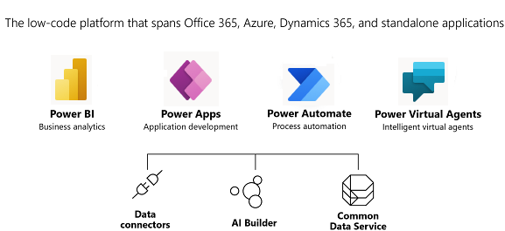
Notes:
The Power Platform puts the “Power” of a robust business “Platform” into the hands of “Citizen Developers.” Every user of Office 365 and Dynamics 365, Power Apps, Power Automate, and others can use their skills and data to customize apps that embed where they’re working. The Power Platform is considered a low-code solution: a place where Citizen developer can work within the functional architecture of the Power Platform, and pro devs can just as easily expose building blocks that let them do even more
For example:
PowerApps user can create an app out of a SharePoint to automatically trigger a notification in Teams when a document has been updated through Power Automate.
A Dynamics 365 customer can go and extend their business applications with new mobile experience.
A Power Platform admin can create a bot in Power Virtual agent that will interact with the chat in a Power Platform Portal to let clients know their shipping information for a recent order.

Slide 3
Common Data Service

Slide 4


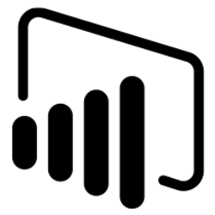



The Common Data Service
The Focal Point for your data
A great place to build and manage apps
Just works with the rest of Microsoft
Building or integrating with CDS means your apps automatically work with other Microsoft apps and services
CDS does the heavy lifting to bring together all your data
We have the tools to let all users build apps and intelligence on their data
Notes:
The Common Data Service, or CDS, lets you securely store and manage data that's used by business applications. Data within the CDS is stored within a set of “entities”, or a set of records used to store data.
The CDS comes with standard entities, and each Dynamics app adds additional entities. For example, Sales has Leads, Goals, and Quotes while Marketing has Segments, and Customer Service has Cases.
You can also create custom entities and expand or re-configure existing entities – and all without using any code.

Slide 5

Data everywhere.
Apps everywhere.
Finance
HR
Self-serve
Travel
Wouldn’t life be easier if everything just worked together?
Notes:
Common Data Service (CDS) brings all your data together in one place so you can focus on the things that matter:
building apps, finding insights, and automating your business processes.

Slide 6
Focal point for data
CDS brings all of a customer’s data together.
Build your app here, benefit from everyone else’s data.
Point-to-point integrations without CDS
Single point of integration with CDS
Flow
Flow
Power BI
PowerApps
Your app here
PowerApps
Other Apps/Services
Power BI
Your app
Other Apps
Dynamics 365
Azure AD
Dynamics 365
Azure AD
Office 365
Office 365
Notes:
The CDS creates a central location from which data is segmented and pushed out to users and applications based on need.

Slide 7
PowerApps

Slide 8
Citizen Developers
No Code or Low Code Innovators delivering line of business applications
Notes:
Powerapps places the power in the hands of Citizen Developers. Using functional tools, Citizen Developers can create custom applications to expand their business needs: All without code.

Slide 9

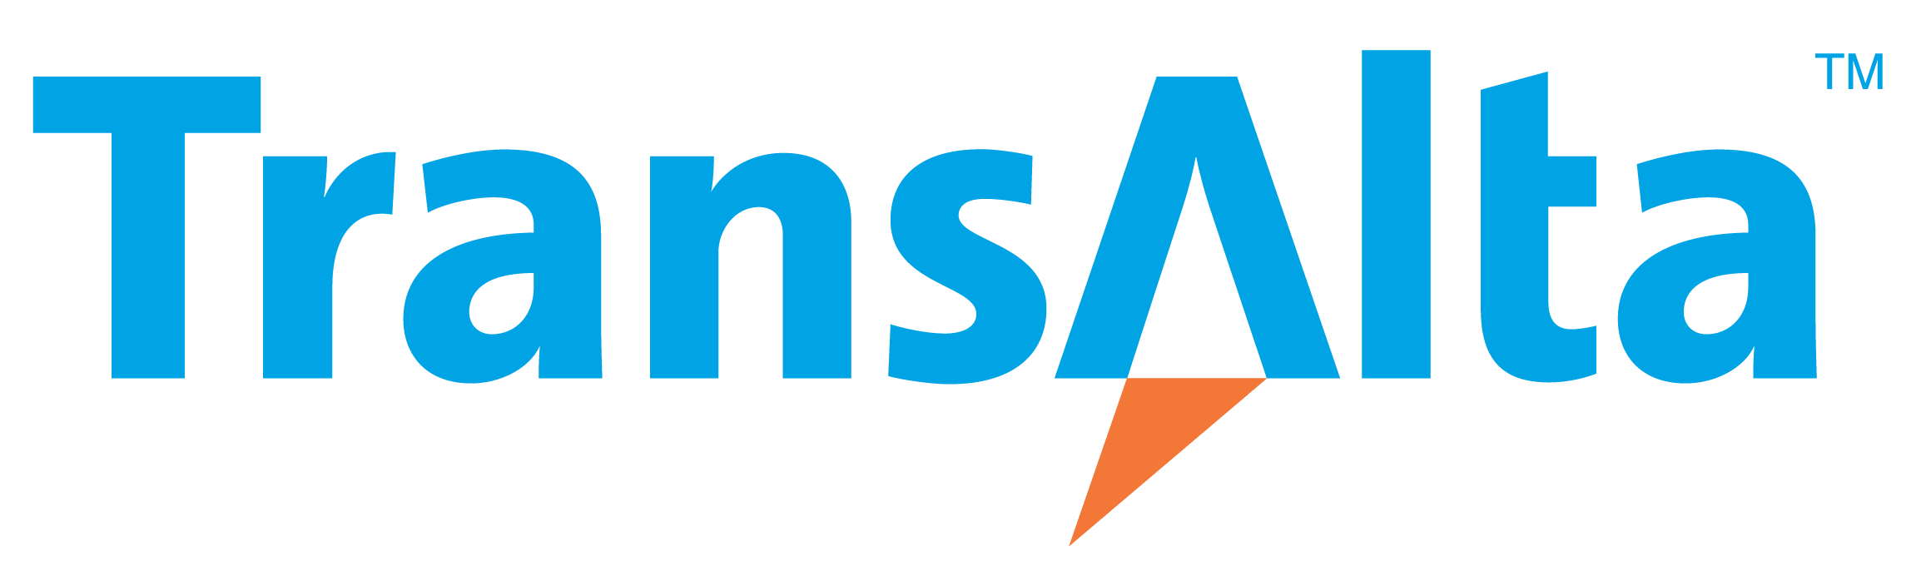



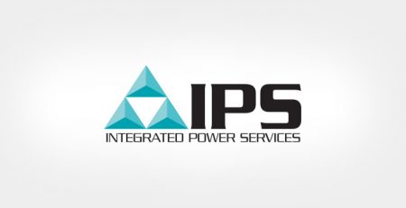

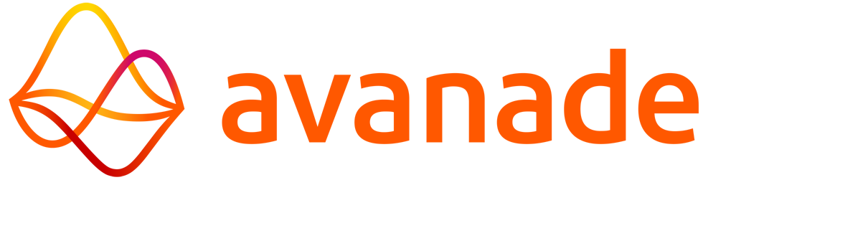


We have over 1M+
monthly active users
People in over 213k+
organizations are using PowerApps and Flow
Notes:
Customers around the world are addressing problems from simple to advanced.
From simple timesheet and survey applications to advanced applications managing car bidding process in car auctions

Slide 10
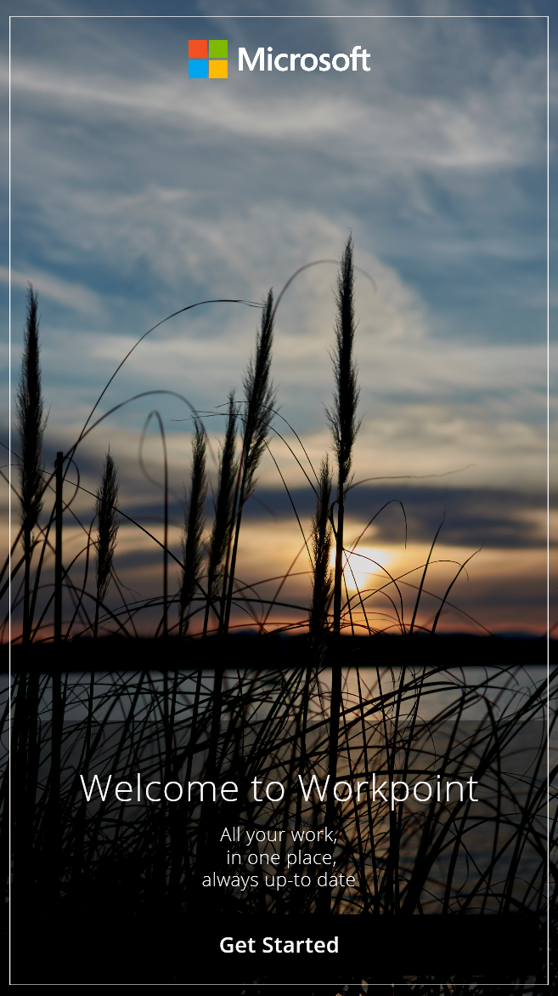


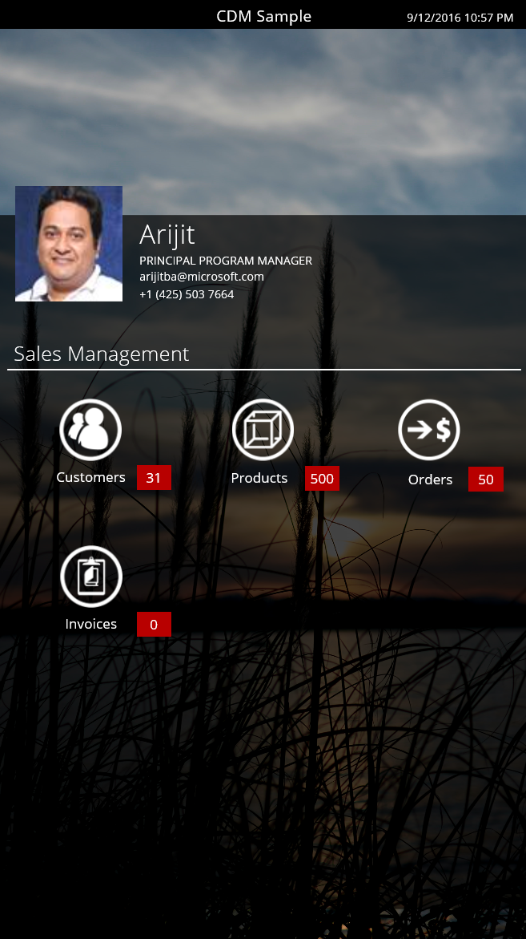
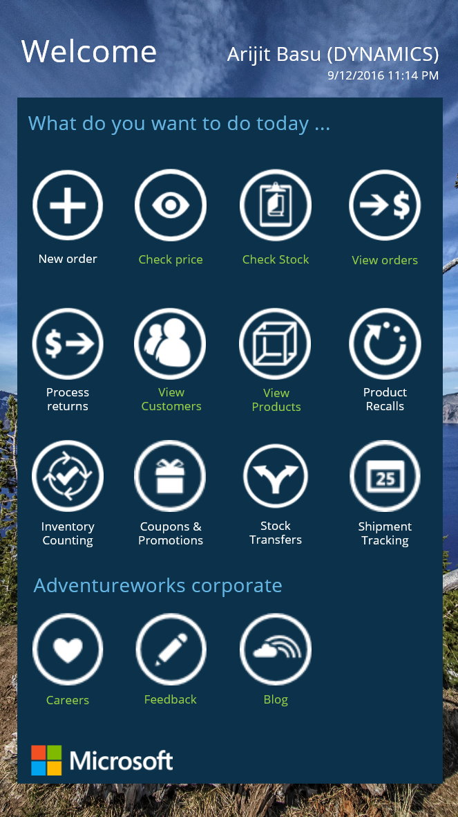

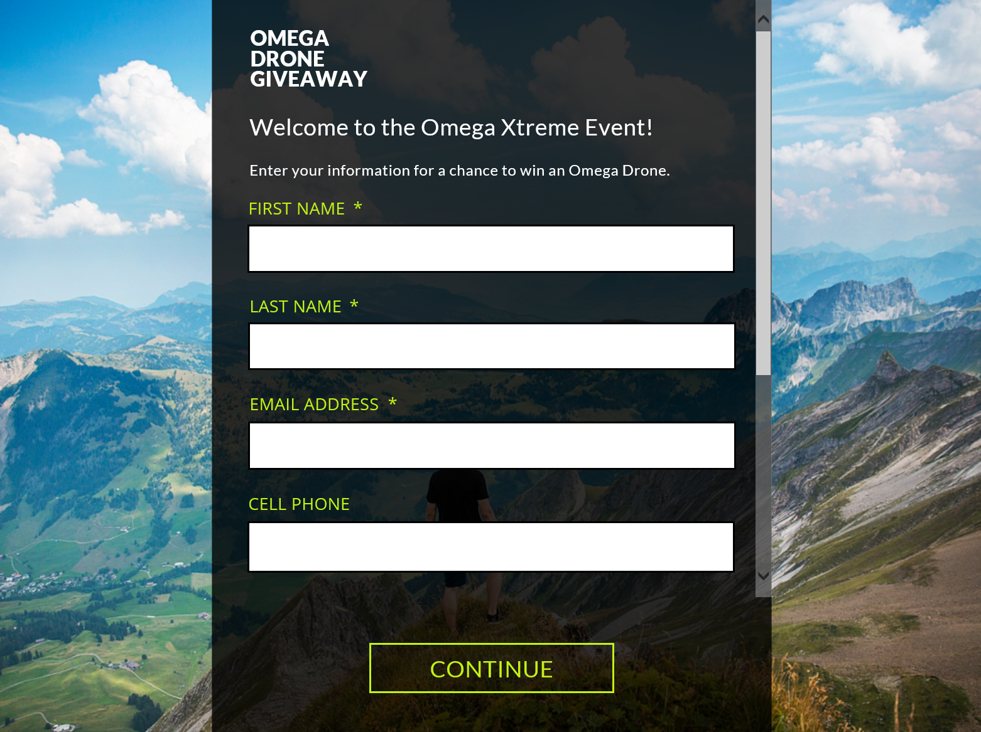
Powerful, simple apps with PowerApps
Notes:
Citizen Developers will create beautiful custom applications that work on Mobile Devices, Tablets, and (one of my personal favorites)….

Slide 11
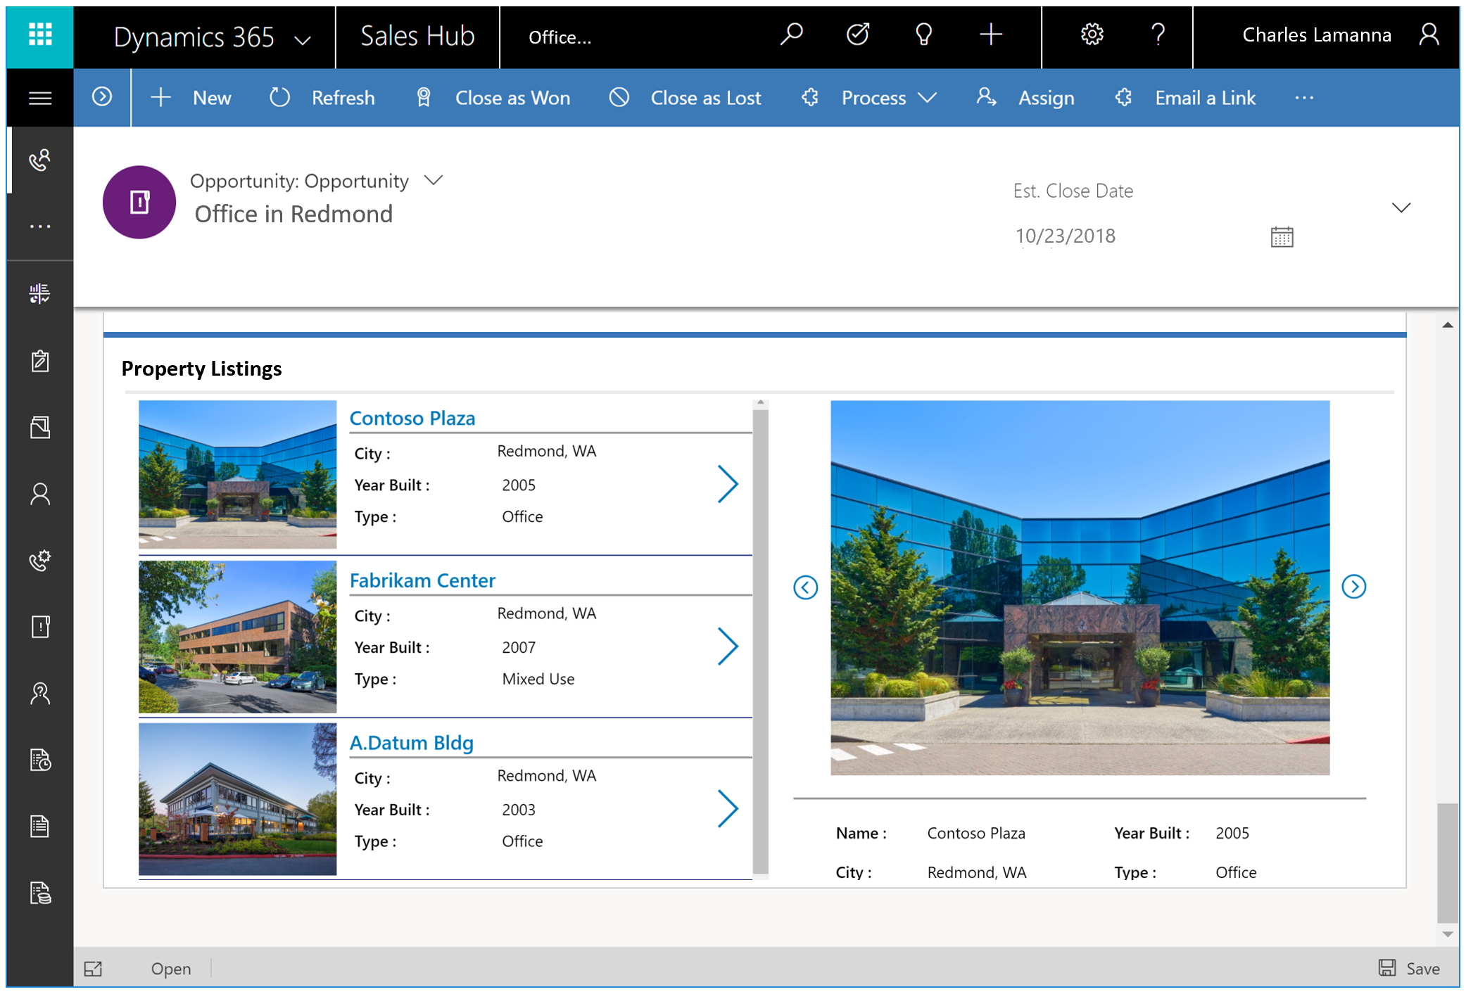
Embedded Apps
Embed canvas app experiences into Model Driven Forms to complete processes that can’t easily be completed otherwise.
Notes:
…can even embed apps into Model Driven forms and Dynamics 365 forms.
One recent example is a client of mine who has incredibly complex processing around their record status updates. In order for the status to be updated, they needed their users to select a number of variable options – based on the user interaction the record would be updated, which would fire various plugins to update multiple other records.
Using an embedded app, we were able to give the client a branded application to interact with their data and update their record status.

Slide 12

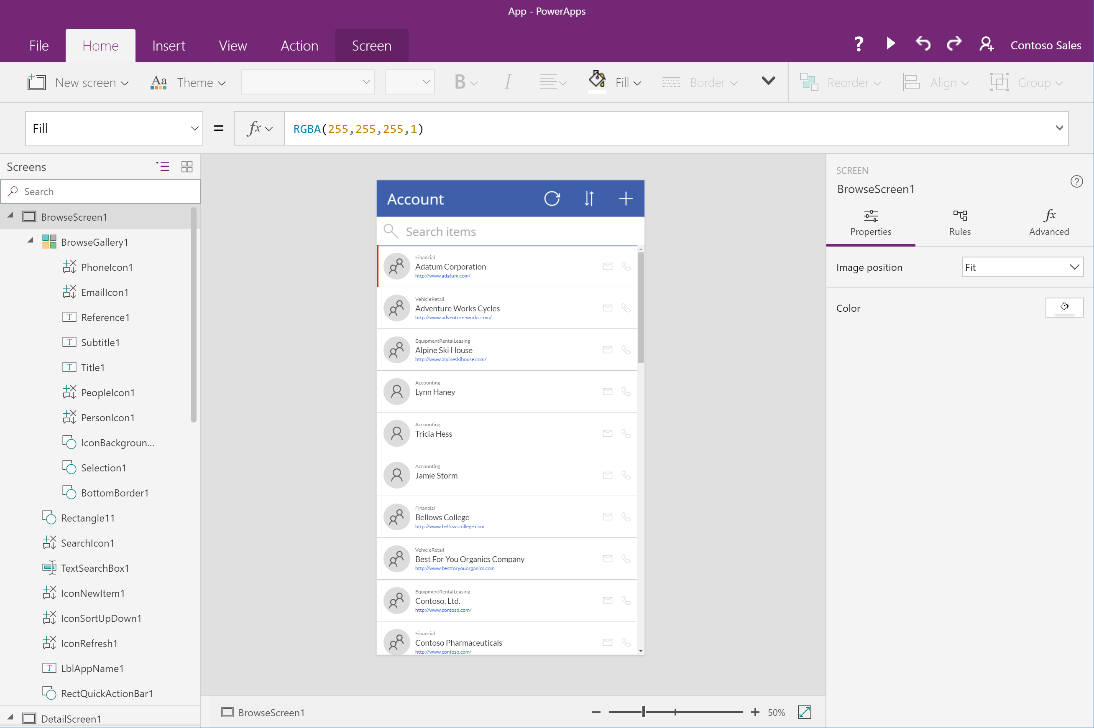
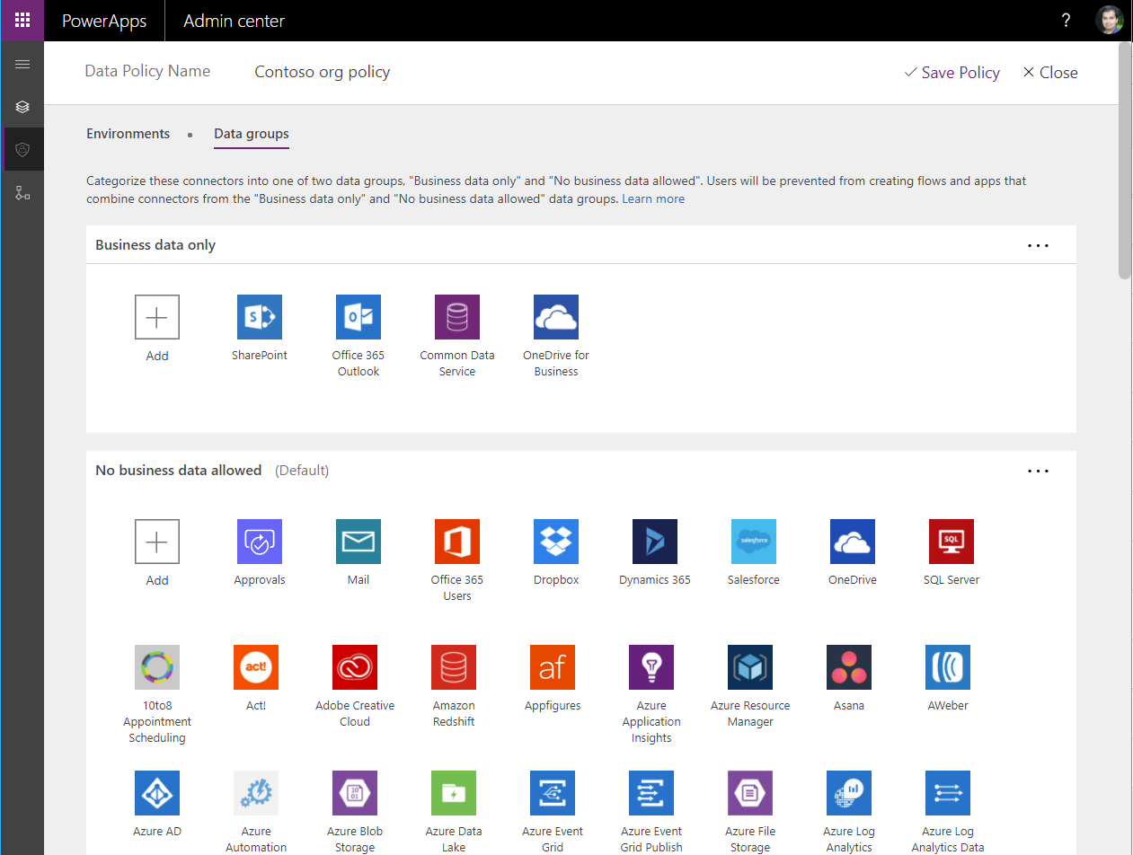
Easy Authoring
Truly WYSIWYG – full control over user experience, use it as you build it
Create app logic with familiar Excel-like expressions
Mash up data from multiple sources right at the app level
Notes:
With Power Apps Canvas Apps, what you see is what you get. Developers get full control over the user experience, whereas, in the past, they’ve been held back by a Model Driven design, which we still use and will talk about this week.
In the past tools for power users often ended up becoming a nightmare tech admins. It meant users were creating business critical apps or databases, but ran them on a computer under their desk, and a kicked out ethernet cable could have a huge impact.PowerApps and Power Automate have been built with an understanding of the needs of IT from the ground up. So we make sure that Powerusers can easily be productive and solve problems and optimize what they do, but also make sure that Tenant admins have full visibility on what apps and flows are running in the company, how much they are used etc.

Slide 13
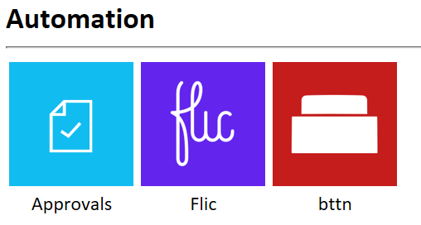
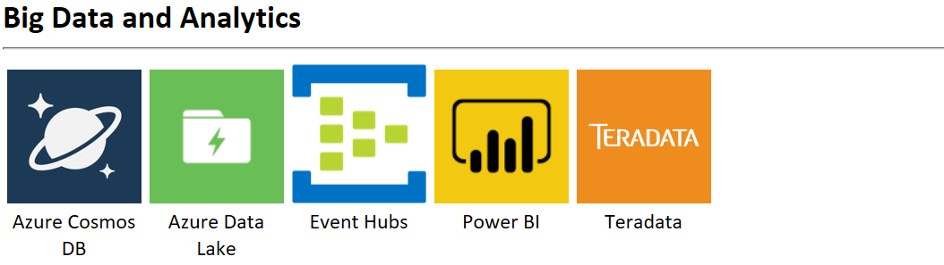
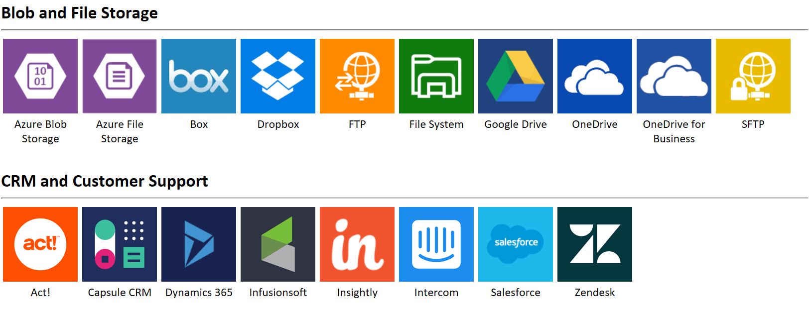
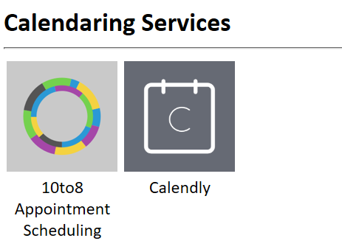
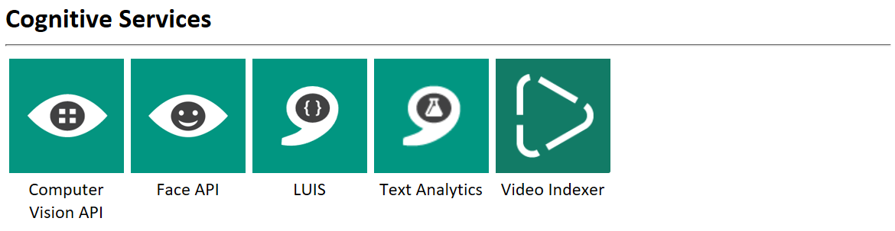
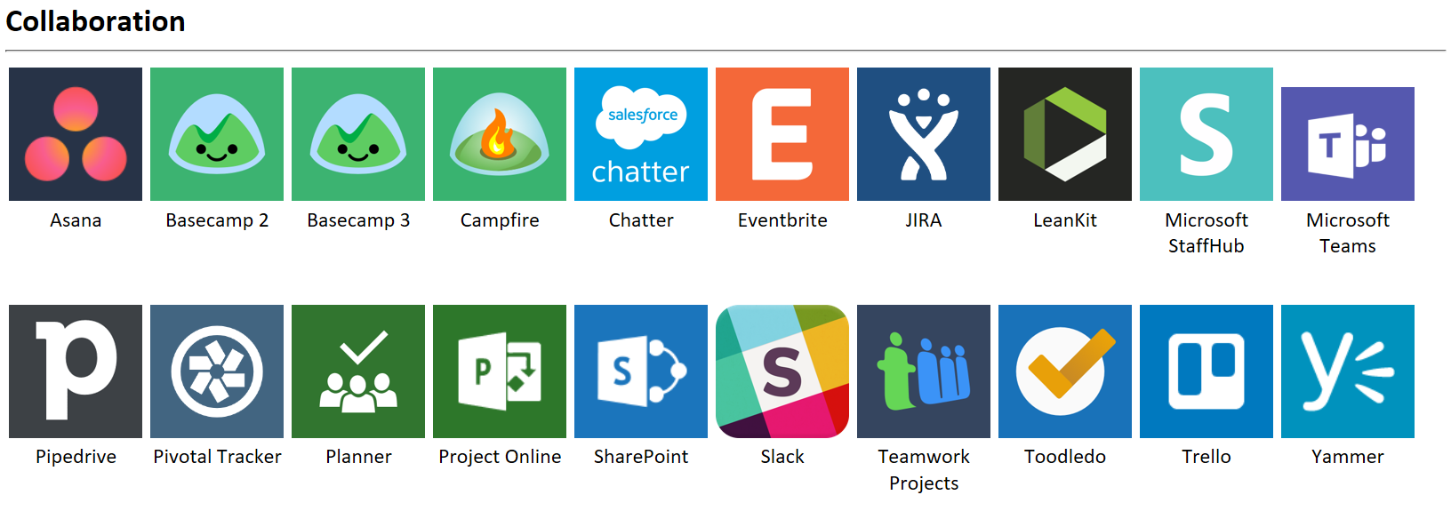
Connected data
Common data service provides a rich platform + standard model that gets creators instantly productive
Add 350+ connected data sources
Add custom connectors and on-premises sources
Notes:
We have DLP policies to enforce restrictions about data flow. For example, to restrict which data sources or connectors can be used with specific servers.
You can see here just a few of the connectors offered. And this list is growing every day! For reference, two years ago there were around 160 connectors. I counted the list a few days ago and counted over 350.
https://docs.microsoft.com/en-us/connectors/connector-reference/connector-reference-powerapps-connectors#list-of-connectors

Slide 14
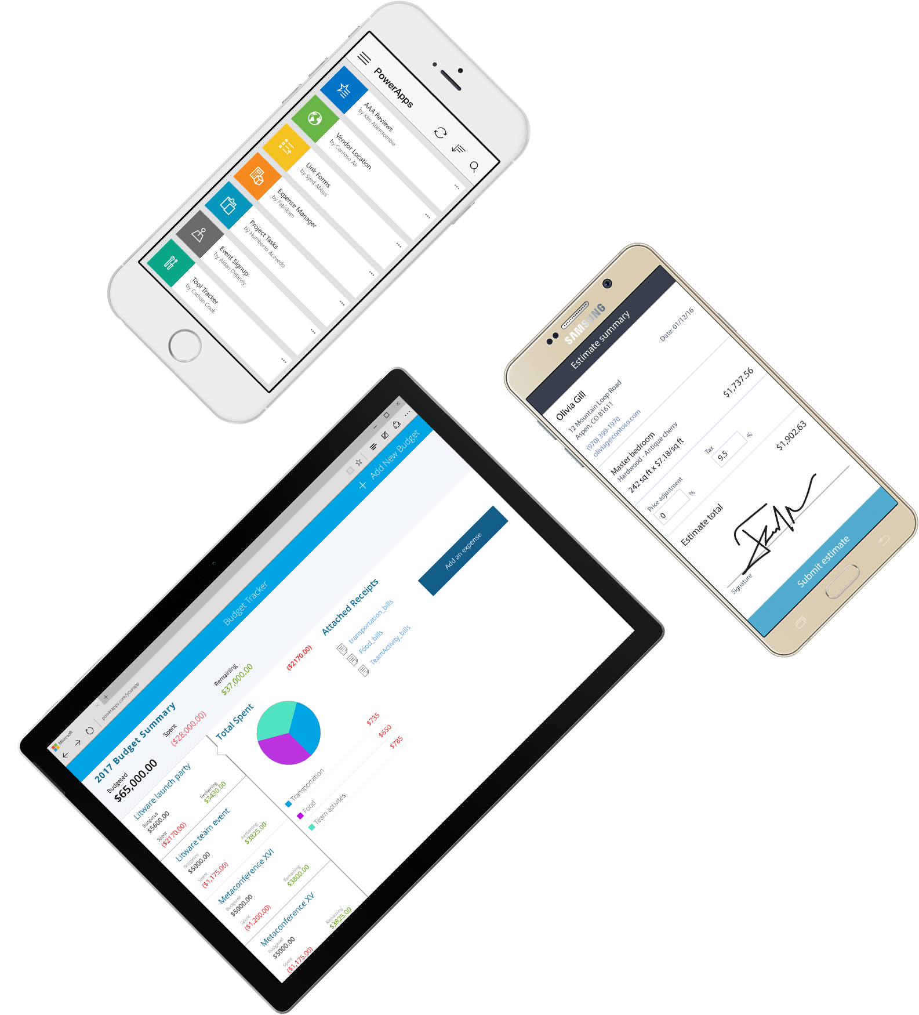
Cross-platform
Publish instantly to iOS, Android, Windows, and the web
Sharing apps is like sharing documents
Manage across environments
Notes:
When using powerapps, you’re going to be publishing instantly across your environment. You entire team will get a push at the same time.
We also have brought the concepts of environments to the platform, to make sure a team can easily administer data, flows and apps for their world (and yes, tenant admin of course can see and manage all of those environments!)
And of course, as you expect from Microsoft we have all the expected compliance certifications you expect, such as HIPAA, SOC, GDPR, Model clause etc.

Slide 15
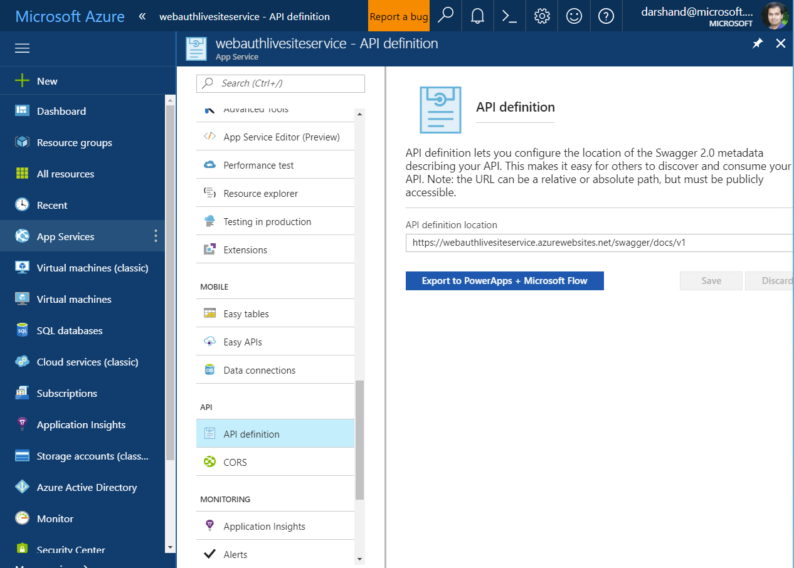
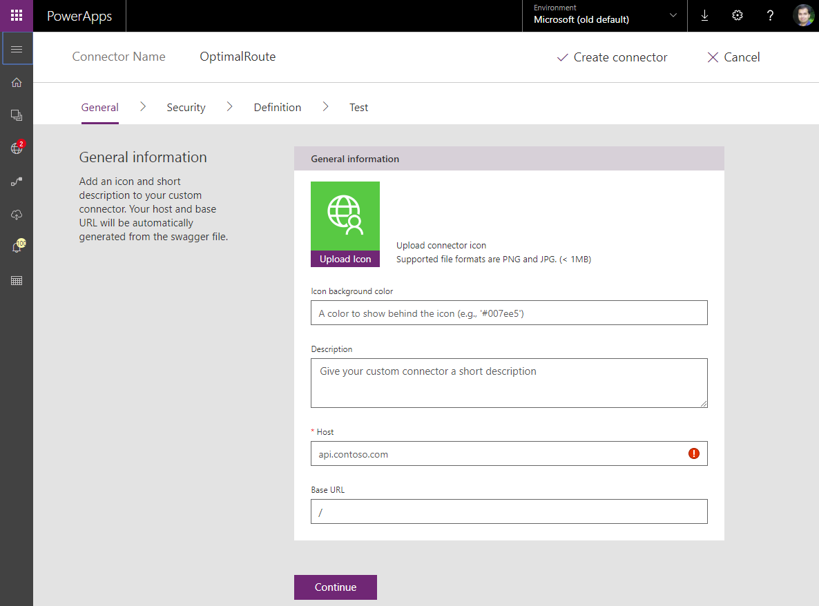
Pro developers welcome…
Build apps that go beyond what you get in the box
Build reusable custom app components & connectors
Leverage the full power of Azure capabilities
Notes:
So, I’ve said a lot about Citizen Developers. But what about the pro developers who maybe tuned out as soon as I said “No Code Needed?” No worries, Professional developers provide a lot of value within our citizen developer world.
One great example is the ability to provide what we call “Custom connectors”. Even though we already have 160+ connectors out the box, I am sure your clients will have some custom systems. Don’t you wish you could use them from PowerApps just like the ones we provide connectors for? That’s where a Pro Developer can come in.
If you need custom code, maybe for some complex scheduling or user interface pop-ups, just have pro devs build it!

Slide 16
Dynamics 365
Notes:
We can’t talk about Powerapps without talking about Dynamics 365.

Slide 17
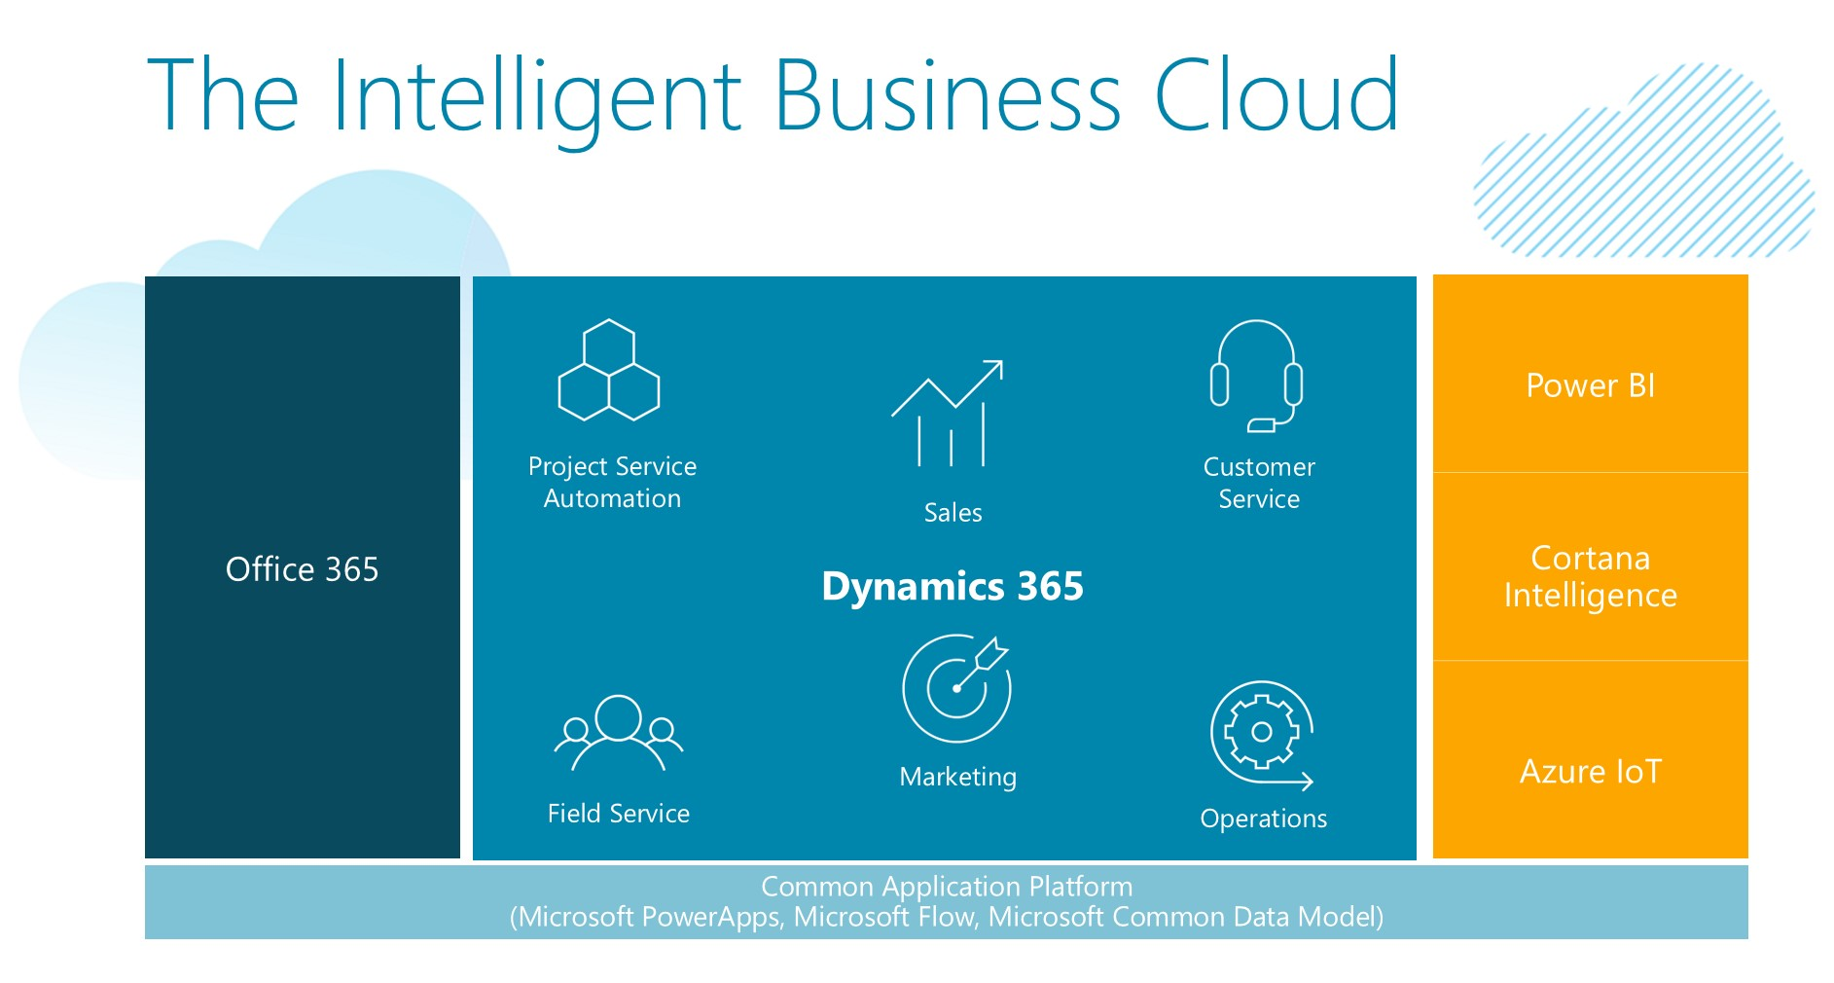
Microsoft Dynamics 365
Notes:
In many ways, each of the Dynamics 365 apps are powerapps. And each app is going to provide a different function.
For example: Sales helps streamline sales processes and focus on nurturing leads and winning opportunities whereas Customer Service might be for a Customer team or center looking to track and manage their case load.
And all of these are built on the CDS. So imagine an organizations where Sales, Customer Service, Marketing and Field service are all running off the same data set using the same Common Data Service database. It puts so much power and information in to the hands of the people using it! Add automation to that and the possibilities are endless.

Slide 18
Power Automate
Notes:
Speaking of automations, lets talk about Power Automate for a bit

Slide 19
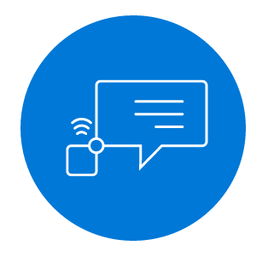
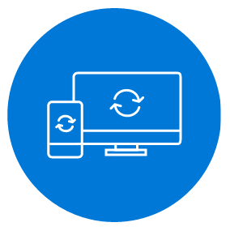
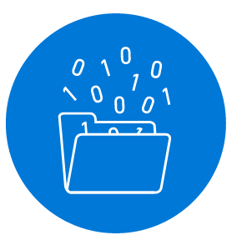

Microsoft Power Automate helps non-developers work smarter by automating workflows across services
Get notifications
Copy files
Collect data
Automate approvals
Notes:
Power Automate is a SaaS services that helps you work smarter by automating workflow across your growing number apps and services that business users rely on.
The possible workflows span across a wide variety of possibilities, for example :
Get a notifications when a certain file is updated.
Automatically update child contact records when their parent Account record is updated.
Turn on your sprinklers with the push of a button
Get a daily weather report.
Streamline approvals and get instant alerts.
Microsoft Flow makes it possible to automate all of these scenarios and more.

Slide 20
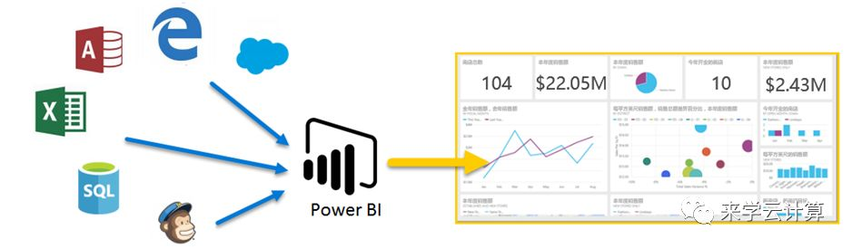
PowerBi
Connect your database(s) to Power BI
Query and Structure your data…
To create actionable and attractive data visualizations.
This Photo by Unknown Author is licensed under CC BY-SA
Notes:
Let’s talk about a few other areas of the power platform. I’ll go through these quickly since I’ve heard rumor that there are a few other guys for you to hear from today.
We’ve got Power BI – a Data Visualization tool. This tool will help you to take the data in your CDS and turn it into actionable information. Power BI is also integrated with Power Apps. Allowing you, for example, to display Power BI Analytics on a Dynamics 365 Sales Hub Dashboard.

Slide 21
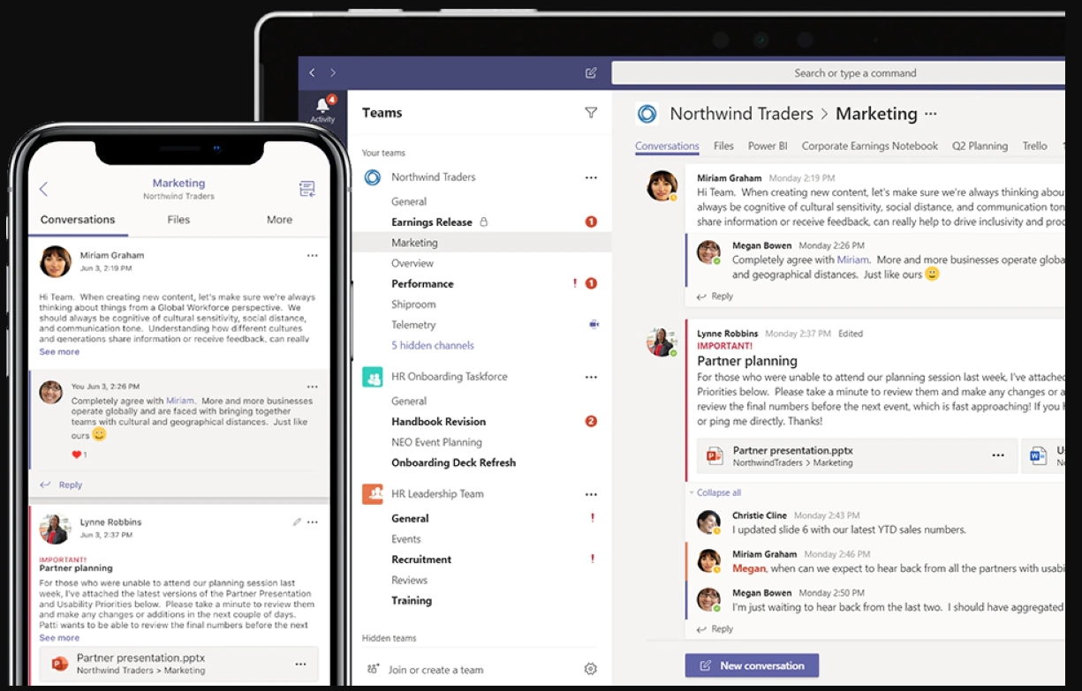
Teams
Use Microsoft teams to expand the Power Platform for greater user access and connectivity
This Photo by Unknown Author is licensed under CC BY-SA-NC
Notes:
Those of your in Modern Workplace may be a little confused. Because, yes, Teams is absolutely part of the Modern Workplace.
However, I rarely do a PowerApps or Dynamics demo these days without including Teams. Especially now, with the release of Project Oakdale.
Inside teams you can embed powerapps, so users can interact with, for example, a timesheet app, directly inside of teams.
Or display a Dynamics 365 view, so that users can see their “Active Opportunities” and open them from within Teams.
Create a bot which will tell your sales team what cases have been assigned to them and how many open cases they have.
Or, use Power Automate to inform a team every time a new lead is created.
There are so many uses for teams, connected to the Power Platform.

Slide 22
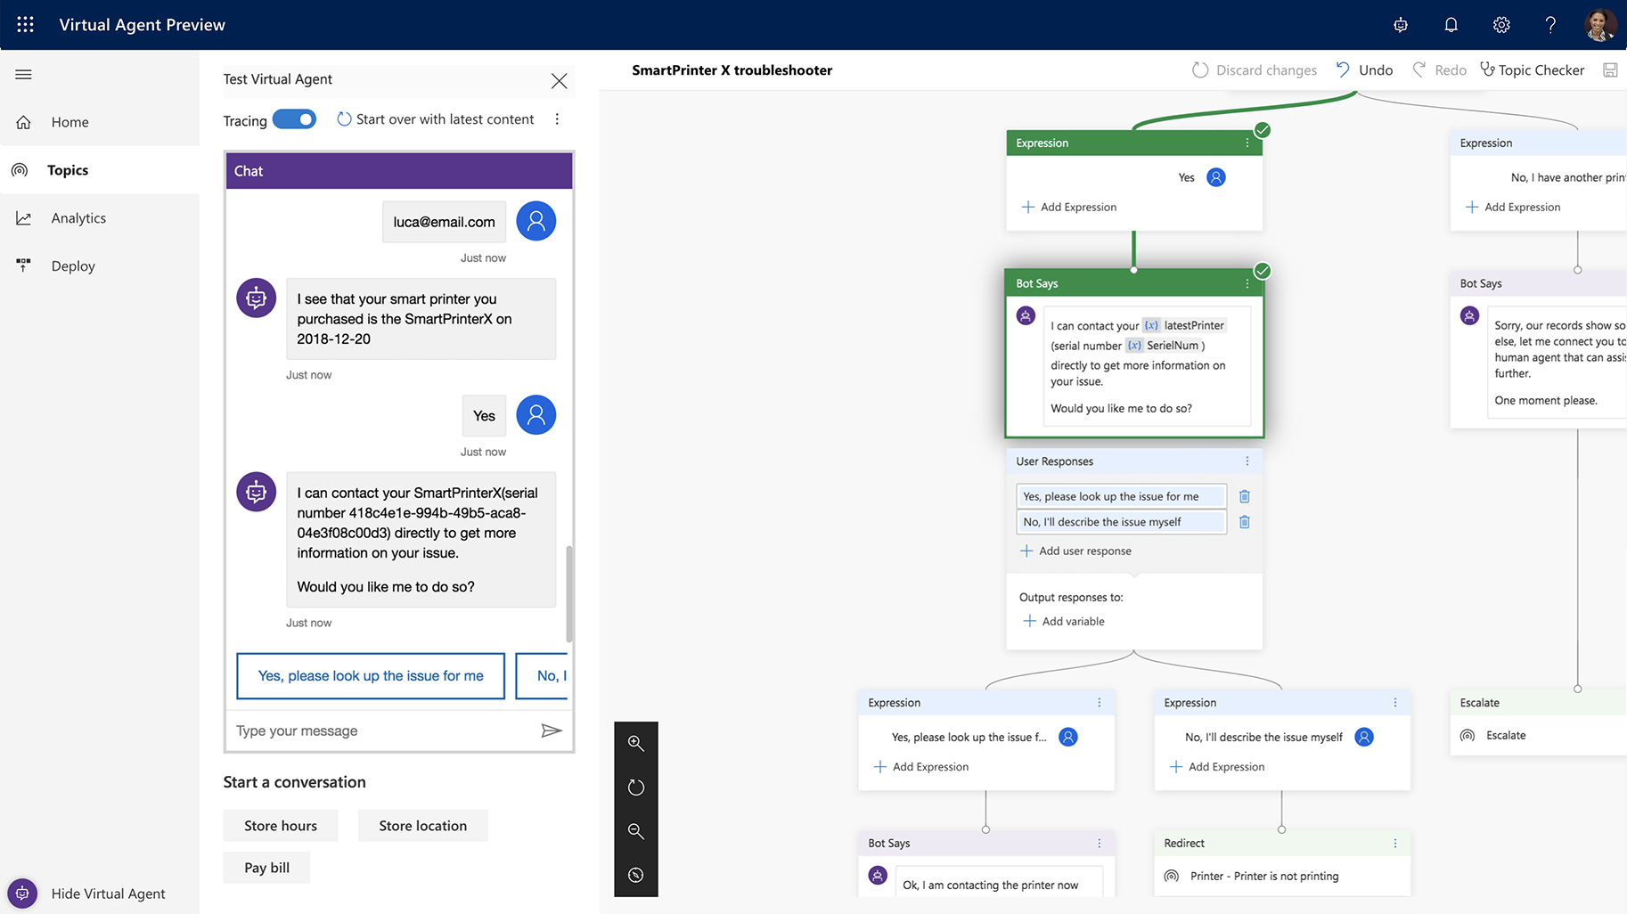
Power Virtual Agent
Create chatbots that users and customers can interact with.
Notes:
This one can be really fun to play with.
Power Virtual Agents gives you the ability to create chatbots based on inputs and outputs. They can be imbedded in teams or portals (among other locations) and can be integrated with Power Automate to create powerful automations.

Slide 23
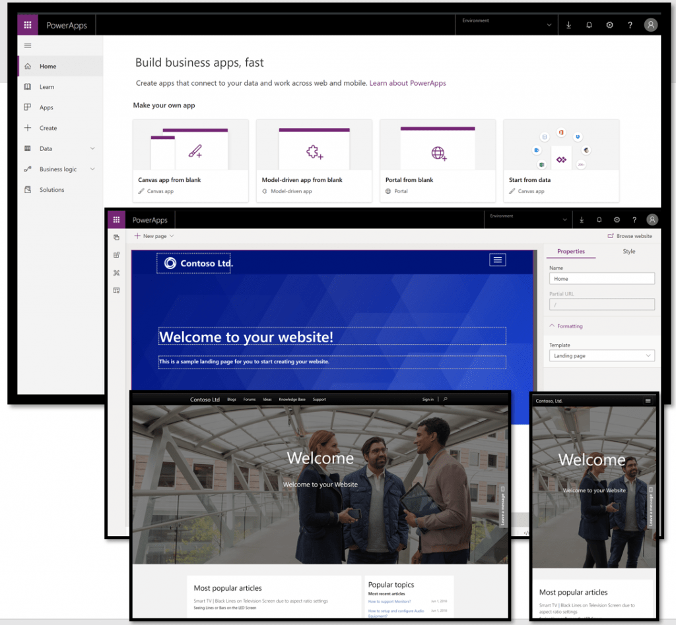
Portals
Low Code solution for creating responsive websites for both external and internal users
Use commercial or enterprise login providers such as Azure, LinkedIn, or others. Or allow anonymous access.
Create brand-specific website content and enrich it with CDS data. Display forms, views, charts, and dashboards built in the CDS
This Photo by Unknown Author is licensed under CC BY-SA-NC
Notes:
Speaking of portals, our final quick review will be in Power Apps Portals.
Portals allows organizations to create external-facing websites that give users access to interact with their CDS data. These customizable portals allow clients to sign in using various identities (including identities from outside providers such as Linked In) and to then create and/or update data held in the Common Data Service.

Slide 24
Notes:
A phrase I’ve started saying often is that the Power Platform is like the Universe: It is ever expanding. I’m excited to begin exploring all it has to offer with some of you!
And with that, I’ll hand things over to…

